Slide 1
Math presentation Name : Mohammed akbar hossen Student Id :223031005
Sub topic :Indices, permutation, differentiation sub code :QA-101

Slide 2

indices
If 2^{x}=3^{y}=6^{-z} ,show that,$\frac{1}{x}+\frac{1}{y}+\frac{1}{z}=0$
sol^{n}: let 2^{x}=3^{y}=6^{-z}=k
$∴2^{x}=k$ $⇒2=k^{\frac{1}{x}}$
$$∴3^{y}=k ⇒3=k^{\frac{1}{y}}$$
$$∴6^{\frac{1}{−z}}=k ⇒6=k^{\frac{1}{−z}}$$
$$∴L.H.S. \\ 6=k^{\frac{1}{−z}} \\ ⇒3.2=k^{\frac{1}{−z}} \\ ⇒k^{\frac{1}{y}}.k^{\frac{1}{x}}=k^{\frac{1}{−z}} \\ ⇒k^{\frac{1}{y}+\frac{1}{x}}=k^{\frac{1}{−z}} \\ ⇒\frac{1}{x}+\frac{1}{y}+\frac{1}{z}=0 R.H.S.$$
$$THUS L.H.S=R.H.S (PROVED)$$

Slide 3

indices
2.Divide $x^{\frac{5}{8}}.y^{\frac{3}{−5}}.z^{\frac{3}{7}} by \sqrt[5]{x^{2}}.\sqrt[3]{y^{4}.}\sqrt[7]{z^{8}} and multiply the quatient by x^{\frac{1}{40}}.y^{\frac{5}{3}}.z^{\frac{5}{7}}$ $$evalute for x=16,y=2^{15}$$
$sol:$ $\frac{x^{\frac{5}{8}}.y^{\frac{−3}{5}}.z^{\frac{3}{7}}}{\sqrt[5]{x^{2}}.\sqrt[3]{y^{4}.}\sqrt[7]{z^{8}}}.$ $x^{\frac{1}{40}}.y^{\frac{5}{3}}.z^{\frac{5}{7}}$
$=\frac{x^{\frac{5}{8}}.y^{\frac{3}{−5}}.z^{\frac{3}{7}}}{x^{\frac{2}{5}}.y^{\frac{4}{3}}.z^{\frac{8}{7}}}.$ $x^{\frac{1}{40}}.y^{\frac{5}{3}}.z^{\frac{5}{7}}$ $$=x^{\frac{5}{8}−\frac{2}{5}}.y^{−\frac{3}{5}−\frac{4}{3}}.z^{\frac{3}{7}−\frac{8}{7}} .x^{\frac{1}{40}}.y^{\frac{5}{3}}.z^{\frac{5}{7}}$$
$$=x^{\frac{9}{40}+\frac{1}{40}}.y^{\frac{−29}{15}+\frac{5}{3}}.z^{\frac{−5}{7}+\frac{5}{7}}$$
$$=x^{\frac{10}{40}}.y^{\frac{−4}{15}}.z^{0}$$
$$={\left(16\right)}^{\frac{1}{4}}.{\left(2^{15}\right)}^{\frac{−4}{15}}$$
$$=2^{1}.2^{−4}$$
$$=\frac{1}{8} ans.$$

Slide 4
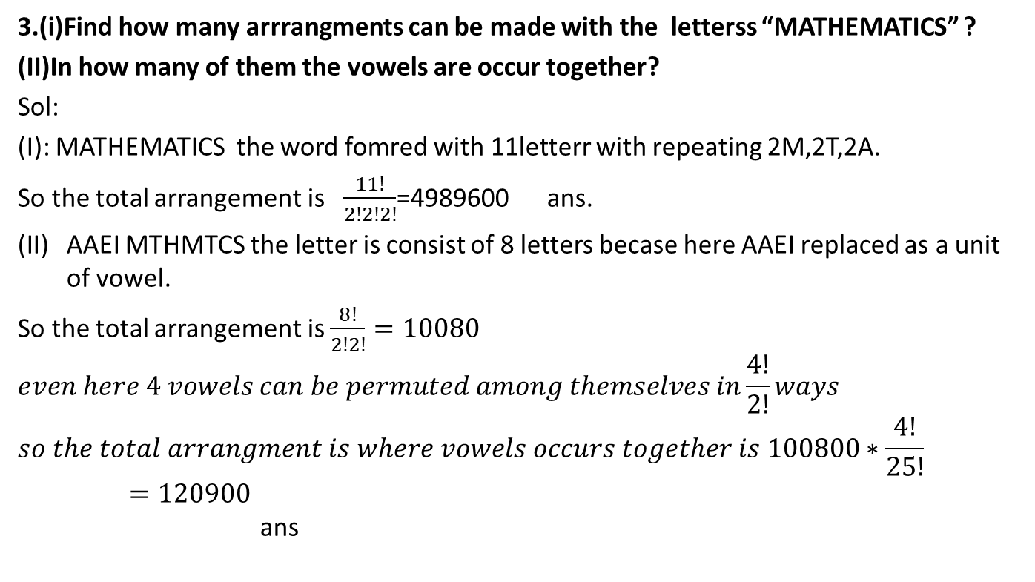
permutation
3.(i)Find how many arrrangments can be made with the letterss “MATHEMATICS” ?
(II)In how many of them the vowels are occur together?
Sol:
(I): MATHEMATICS the word fomred with 11letterr with repeating 2M,2T,2A.
So the total arrangement is $\frac{11!}{2!2!2!}$=4989600 ans.
AAEI MTHMTCS the letter is consist of 8 letters becase here AAEI replaced as a unit of vowel.
So the total arrangement is $\frac{8!}{2!2!}=10080$ $$even here 4 vowels can be permuted among themselves in\frac{4!}{2!}ways \\ so the total arrangment is where vowels occurs together is 100800∗\frac{4!}{25!}=120900$$ ans

Slide 5

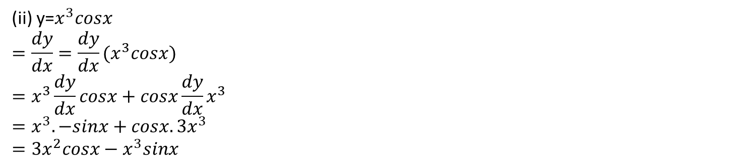
Differentiation
5.Finding the derivatives of the following functions with respect to X.
Y=($4x^{3}−3x^{2})(6x+\log_{e}{x^{2})}$ $⇒\frac{dy}{dx}=$($4x^{3}−3x^{2})\frac{dy}{dx}(6x+\log_{e}{x^{2})+}$( $6x+\log_{e}{x^{2})}\frac{dy}{dx}(4x^{3}−3x^{2})$ $=\left(4x^{3}−3x^{2}\right)\left(6+\frac{2x}{x^{2}}\right)+(6x+\log_{e}{x^{2})}(12x^{2}−6x)$
ans.
(ii) y=$x^{3}cosx$ $$=\frac{dy}{dx}=\frac{dy}{dx}{(x}^{3}cosx) \\ =x^{3}\frac{dy}{dx}cosx+cosx\frac{dy}{dx}x^{3} \\ =x^{3}.−sinx+cosx.3x^{3} \\ =3x^{2}cosx−x^{3}sinx$$
Ans.

Slide 6
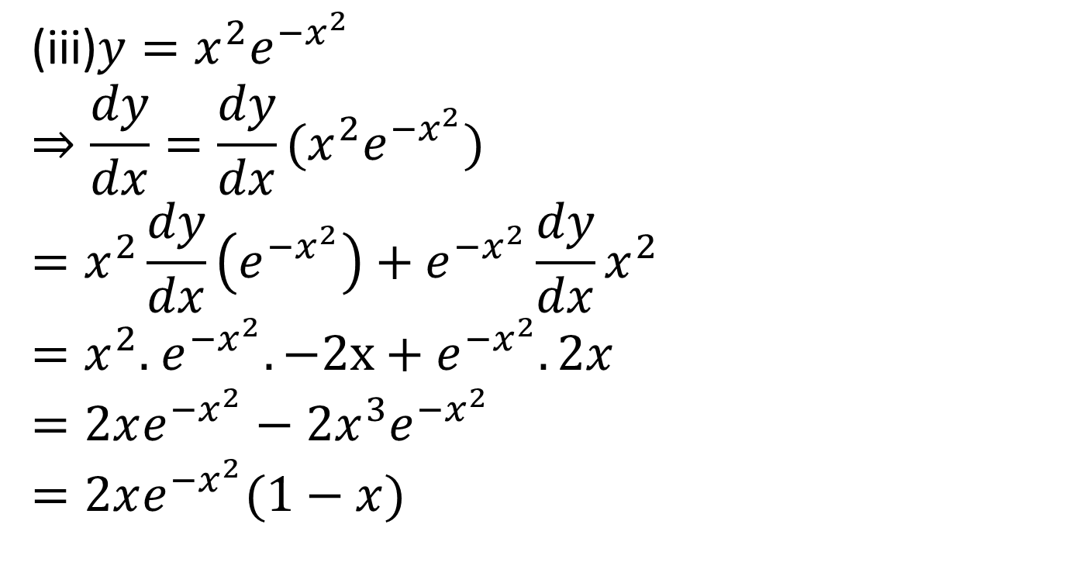
Differentiation
(iii)$y=x^{2}e^{−x^{2}}$ $$⇒\frac{dy}{dx}=\frac{dy}{dx}{(x}^{2}e^{−x^{2}}) \\ =x^{2}\frac{dy}{dx}\left(e^{−x^{2}}\right)+e^{−x^{2}}\frac{dy}{dx}x^{2}$$ $=x^{2}.$ $e^{−x^{2}}.−2x+e^{−x^{2}}.2x$ $$=2xe^{−x^{2}}−2x^{3}e^{−x^{2}}$$ $=2xe^{−x^{2}}(1−x)$
Ans.

Slide 7
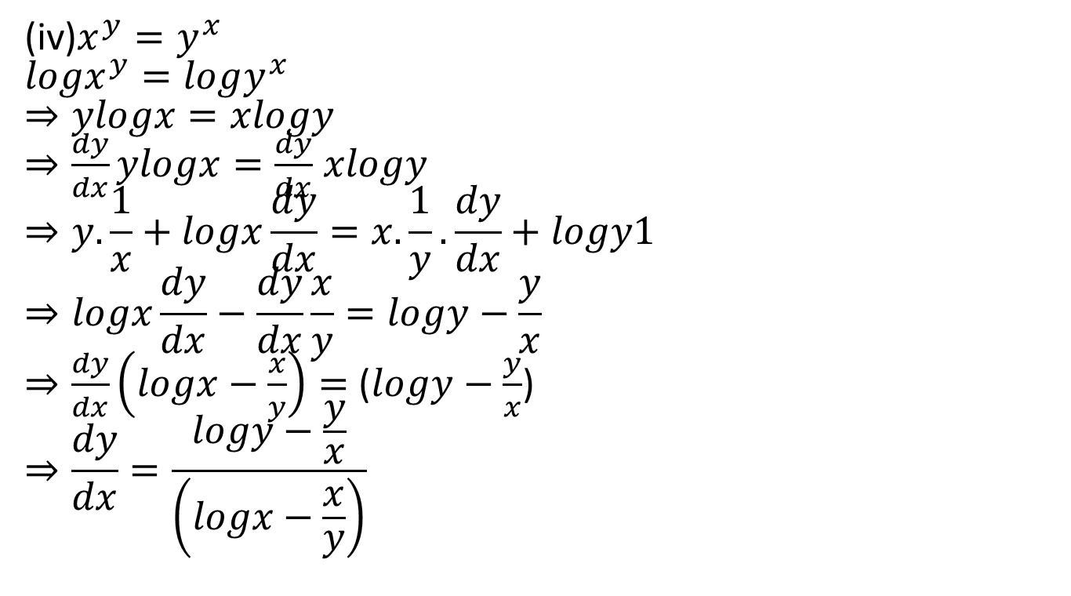
differentiation
(iv)$x^{y}=y^{x}$ $${logx}^{y}=logy^{x} \\ ⇒ylogx=xlogy$$ $⇒\frac{dy}{dx}ylogx=\frac{dy}{dx}$ $xlogy$ $$⇒y.\frac{1}{x}+logx\frac{dy}{dx}=x.\frac{1}{y}.\frac{dy}{dx}+logy1 \\ ⇒logx\frac{dy}{dx}−\frac{dy}{dx}\frac{x}{y}=logy−\frac{y}{x}$$ $⇒\frac{dy}{dx}\left(logx−\frac{x}{y}\right)=$ ($logy−\frac{y}{x}$) $$⇒\frac{dy}{dx}=\frac{logy−\frac{y}{x}}{\left(logx−\frac{x}{y}\right)}$$
Ans .

Slide 8
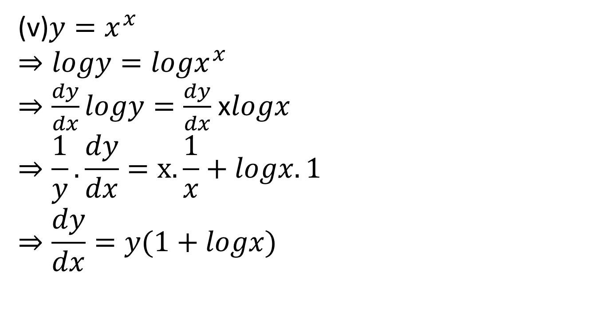
differentiation
(v)$y=x^{x}$ $$⇒logy=logx^{x}$$ $⇒\frac{dy}{dx}logy=\frac{dy}{dx}$ x$logx$ $$⇒\frac{1}{y}.\frac{dy}{dx}=x.\frac{1}{x}+logx.1 \\ ⇒\frac{dy}{dx}=y(1+logx)$$
Ans .

